Slide 1
Express JS

Slide 2
Why Express?
Organizations from different domains, are using Node.js as a preferred runtime environment, for their web applications.
Some web- development tasks tasks needs a lot of coding in Node.js.
Implementing Routing for different paths and implementation of route handlers for different HTTP verbs POST, Get.
Serving HTML, CSS static files.
Sending dynamic response using templates etc.,

Slide 3
Express.js is the most popular framework for creating web applications in Node.js.
It is lightweight and provides easy connectivity with different databases.
Using Express, we can handle requests and manage routes.

Slide 4
Express is a perfect framework for performing high-speed input and output operations.
Advantages of using Express:
Has Robust API's which will help us to easily configure routes for sending and receiving the data between browser and database.
Takes less time and fewer lines of code thereby simplifying the application development and making it simple to write safe and modular applications.
Have been used in different domains like business, finance, news, social, etc.

Slide 5
What is Express?
Express.js is widely used for building server-side applications by using node js.
Features:
Easy routing: Express makes it easy to define routes for your application and handle HTTP requests and responses.
Middleware support: Express provides a flexible middleware architecture that allows you to easily add functionality to your application, such as authentication, logging, and error handling.

Slide 6
Template engines: popular options like Handlebars and Pug, allowing you to easily generate dynamic HTML pages, by parsing the template file and replaces the placeholders with actual data to generate a final output.
Scalability: Express is designed to be lightweight and flexible, making it a great choice for building scalable applications that can handle a large number of users and requests.

Slide 7
Large ecosystem: Express has a large and active community, with a wide range of plugins and modules available that can be used to add additional functionality to your application.
Overall, Express.js provides developers with a simple, efficient, and flexible way to build web applications with Node.js, making it a popular choice for building both small and large-scale web applications.

Slide 8
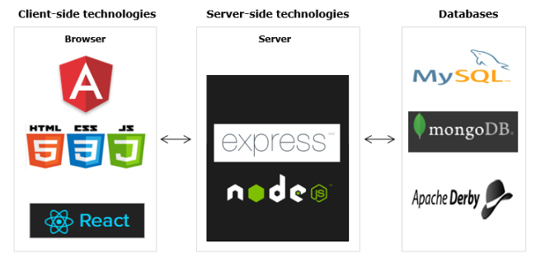
Express in web application stack

Slide 9
Express places itself on the server-side in the complete application stack and provides a complete server-side solution for application development.
Express works well with any client-side technology like Angular, React, etc. and any database like MongoDB, MySQL can be used.

Slide 10
Express Development Environment
To develop an Express application on a local machine, a development environment with the installation of the below packages are to be set up.
Node.js
Express
Express-generator
Step 1:
Install Node.js from the software house/software center.

Slide 11
Follow the instruction to check the Node version installed in the machine.
Open Node command prompt and give the following command.
node -v
Step 2:
Installation of Express is straightforward if you have Node.js installed on your machine.
Express can be installed using the node package manager (npm).
Now install Express using the following command:
npm install express -g

Slide 12
Step 3:
Express Generator is a command-line tool that helps you quickly create a basic skeleton of an Express application.
For installing the express-generator tool globally, use the following command.
npm install express-generator -g
Once the generator is installed, it is extremely simple to create the application using the 'express' command.

Slide 13
Once the installation is complete, you can create a new Express application using the following command:
express <<application_name>>
It will automatically generate a folder with the supplied application name. Inside the folder, there will be a set of folders and files which are created by the generator tool.

Slide 14



Development Environment- steps
1. Install Express.
2. Install Express-generator
3. To create a new Express application named 'myApp'.
This will create a new directory called myApp with a basic Express application structure.

Slide 15
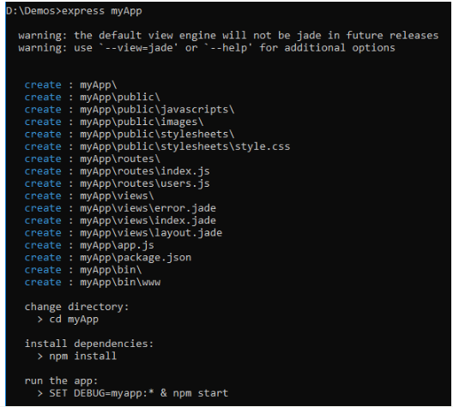

Slide 16
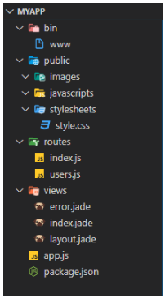
4. Observe the new project structure generated.

Slide 17
Install dependencies: Navigate to the newly created directory myapp and install the required dependencies by running:
cd myapp
npm install
This will install all the necessary dependencies specified in the package.json file.

Slide 18
Folder description:
bin: Contains the configuration file for the environment.
public: Contains the static files which we can use in the application.
routes: Contains all the routes created in the application.
views: Contains the view templates, default jade template files, responsible for presenting data to the user in a way that is easy to understand and interact with..
app.js: Contains application-level configurations and the starting point of the application.

Slide 19
package.json: The package.json file is usually present in the root directory of a Node.js project.
This file helps npm to identify the project and handle its dependencies.
It consists of other metadata, vital to end-users, such as the description of the project, its version, license information, other configuration data, etc.

Slide 20
Code linting
We will be writing the logic in the application based on the requirements provided, but as a developer, we must take care of the standards of the code.
We will explore ESLint and learn how to ensure the coding standards are followed in the code.
Install eslint module global to the machine.
npm install eslint -g

Slide 21
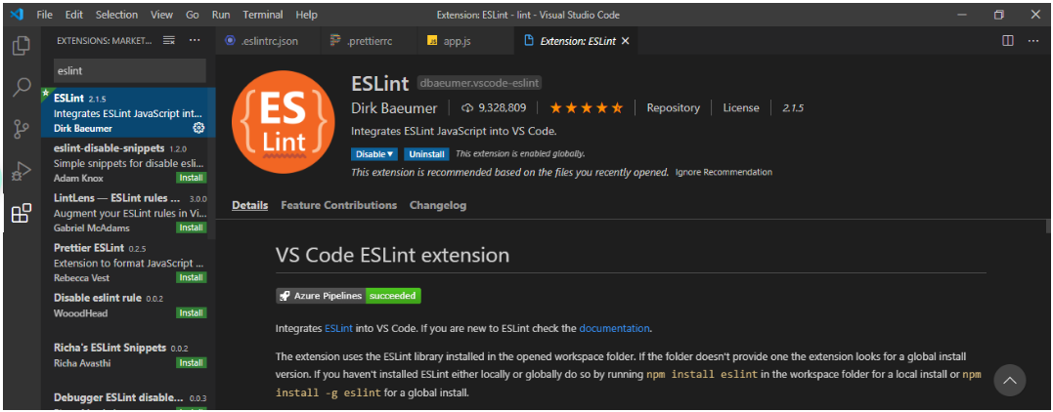
After installing the node modules enable ESLint from the extensions of VSCode.

Slide 22
Basic Configuration:
To create a basic eslint config file follow the steps given.
1. Create an eslint config file for this folder using the below command:
eslint --init

Slide 23

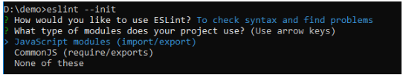
The following 3 options will be available for the user to choose from.
Based on the requirement we can choose any of these.
2. Choose the type of module which will be used in the project.

Slide 24
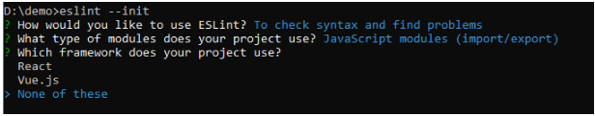

4. Choose the framework based on the requirement.
5. Select whether Typescript is used in the application.

Slide 25
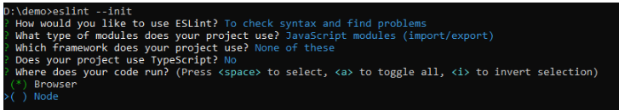
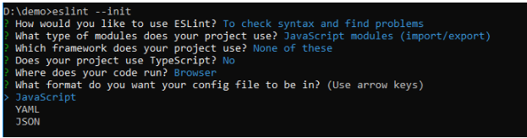
6. Choose where the application will primarily run.
7. Select the format in which you need to create the config file.

Slide 26
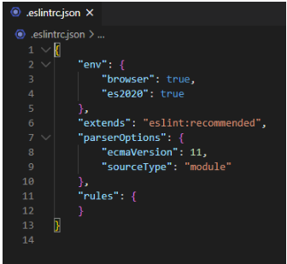
8. On successful installation of all required modules, the config file ".eslintrc.json" will be created in the project.
You can further explore and add other options to the config file based on the need.
Proceed to advanced configuration for more options.

Slide 27
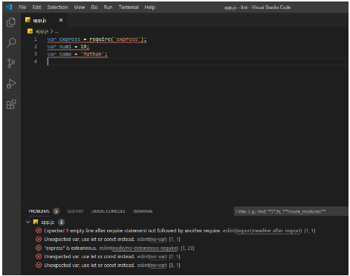
Code with ESLint problems

Slide 28
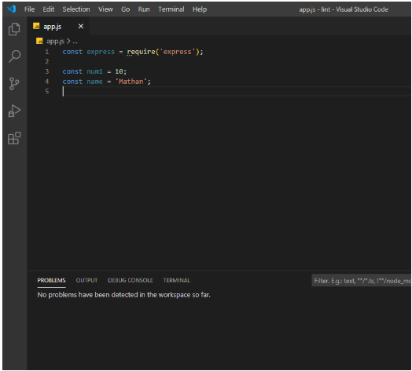
Updated code without ESLint problems:

Slide 29
Why Routing?
To explore the various features available in any web application, we need to request the correct URL for the specific feature we are currently interested in.
Routing refers to the process of directing incoming requests to the appropriate handler functions in the server.

Slide 30
For a web application, all the URLs will reach the same server, but paths will be different. It is the server's responsibility to route the URLs to the appropriate features depending on the path.
Here, "http://localhost:3000/" has the address and port number of the machine where the server is hosted and "/" is the path.

Slide 31
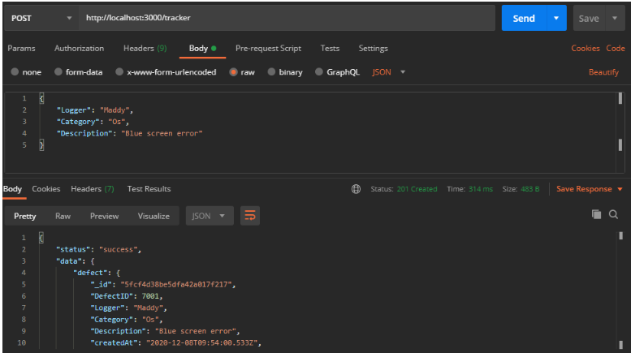

Slide 32
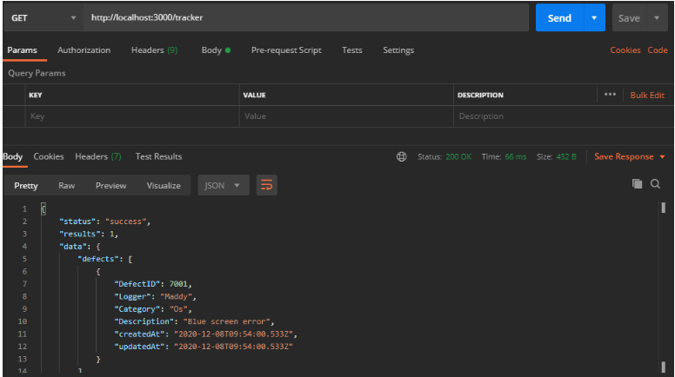
When a GET request is sent to the server with the URL http://localhost:3000/tracker, the GET request is fired which fetches all defects.

Slide 33
In the above two examples, we see that all the requests are received by the same server running on port 3000.
However, depending on the path and HTTP method, different responses are coming from the server.
The server needs to decide which response is to be sent for a particular path in the URL.
Express provides routing API to help to manage these requirements whenever a request is received by the server.

Slide 34
What is Routing?
Defining the endpoints of an application and the way the application responds to the incoming client requests are referred to as routing.
A route is nothing but a mixture of a URI, HTTP request method, and some handlers for that particular path.
Routing can be defined using two ways
Application Instance
Router class of Express

Slide 35
Method 1: Application Instance
We can do routing using the application object.
const express = require('express');
const app = express();
app.get('/', myController.myMethod);
app.get('/about', myController.aboutMethod);

Slide 36
Routing using Application Instance
In Express.js, you can handle routes using the application instance by calling the relevant HTTP method on the app object and specifying the route and callback function to be executed for that route.
Example:
const express = require('express');
const app = express();
// Handle GET request for the root route
app.get('/', (req, res) => {
res.send('Hello World!');
});

Slide 37
// Handle POST request for the /login route
app.post('/login', (req, res) => {
// handle login logic here
});
// Handle PUT request for the /users/:id route
app.put('/users/:id', (req, res) => {
const userId = req.params.id;
// handle update user logic here
});

Slide 38
// Handle DELETE request for the /users/:id route
app.delete('/users/:id', (req, res) => {
const userId = req.params.id;
// handle delete user logic here
});
app.listen(3000, () => {
console.log('Server listening on port 3000');
});

Slide 39
In this example, we define routes for handling HTTP GET, POST, PUT, and DELETE requests.
For each route, we call the relevant HTTP method on the app object and specify the route path and a callback function that will be executed when the route is accessed.
The callback function takes two arguments: the request object (req) and the response object (res), which can be used to handle the request and send a response back to the client.

Slide 40
Note that the order in which you define your routes is important in Express.js.
Routes are processed in the order in which they are defined, so if you have multiple routes that match the same path, the first one that matches will be used.
It's generally recommended to define more specific routes before less specific ones to avoid unexpected behavior.

Slide 41
Method 2: Router class of Express
Let's use the express.Router class. Router class helps in grouping the route handlers together for a site and allows them to access them using a common route-prefix.
The below code explains how to define routes in an Express application.
route.js file:
const express = require('express');
const router = express.Router();
router.get('/', myController.myMethod);
router.get('/about', myController.aboutMethod);
module.exports = router;

Slide 42
Now to use the route module created above, we need to import it and then associate it with the application object. In app.js file include the below code:
const express = require('express');
const router = require('./routes/route');
const app = express();
app.use('/', router);
This application will now be able to route the paths defined in the route module.

Slide 43
Defining a route
A route can be defined as shown below:
router.method(path,handler)
router: express instance or router instance
path: is the route where request runs
handler: is the callback function that gets triggered whenever a request comes to a particular path for a matching request type.
Route Method:
The application object has different methods corresponding to each of the HTTP verbs (GET, POST, PUT, DELETE). These methods are used to receive HTTP requests.

Slide 44
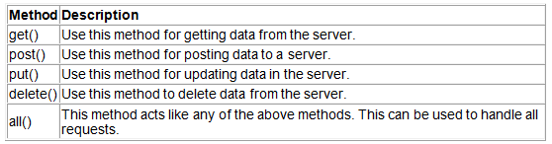
Below are the commonly used route methods and their description:
Examples:
routing.get("/notes", notesController.getNotes);
routing.post("/notes", notesController.newNotes);
routing.all("*", notesController.invalid);

Slide 45
Here, notesController is the custom js file created to pass the navigation to this controller file.
Inside the controller, we can create methods like getNotes, newNotes, updateNotes, etc. to perform various database related queries like reading from the database, inserting into the database, etc.

Slide 46
Route Paths
Route path is the part of the URL which defines the endpoint of the request.
For the URL "http://localhost:3000/" - ‘/’ is the endpoint.
For the URL "http://localhost:3000/about" - ‘/about’ is the endpoint.
We can handle the endpoints as follows, in an Express application.
router.get('/',myController.myDefaultMethod);
router.get('/about',myController.aboutMethod);
In the above example, we have strings like '/' and '/about' as part of the route path. The path can also be string patterns or regular expressions.

Slide 47
String-based routes: Pass a string pattern as the first parameter of the routing method.
router.get('/ab*cd', myController.myDefaultMethod);
The above route definition responds to all the paths starting with "ab" and ending with "cd".
For eg: "/abxyzcd", "/abbcd". The request will be handled by the route handler, myDefaultMethod written in myController.

Slide 48
Regular expression routes: Pass a regular expression object as the first parameter to the routing method.
router.get('/x/',myController.myMethod);
The above route definition responds to any path with an 'x' in the route name.
In a general web application, string-based routes are used mostly and regular expression-based routes are used only if required absolutely.

Slide 49

Handling Routes
Route handler can be defined as functions that get executed every time the server receives a request for a particular URL path and HTTP method.
The route handler function needs at least two parameters: request object and response object.
Request object:
The HTTP request object is created when a client makes a request to the server. The variable named req is used to represent this object.
The request object in Express provides many properties and methods to access the request related information sent by the client to the server.

Slide 50
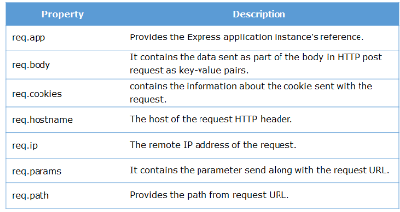
Below are some commonly used methods of the request object.

Slide 51

Response object
The HTTP response object has information about the response sent from the server to the client. The response object is created along with the request object and is commonly represented by a variable named res.
The route handler function sends a response using res.send() method whenever a GET request is received.
res.send('About us page');
The response object in Express also supports many methods for sending different types of responses.

Slide 52
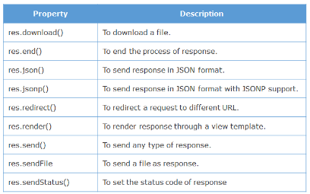
Have a look at some commonly used methods of the response object.

Slide 53
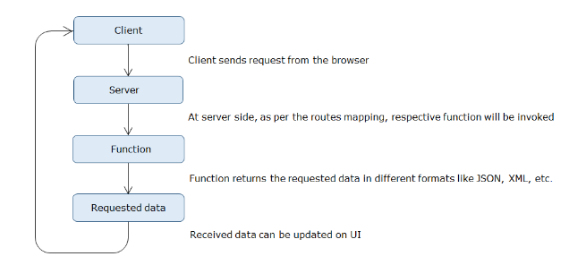
Have a look at the basic architecture of Express routing.

Slide 54
Whenever a client sends a request to the server, that request is forwarded to the corresponding route handler function.
The function process the request and then generates the response that is to be sent back to the client.
The client will be able to see the response in the browser.

Slide 55
Handling Routes-an example
Router code to understand how routes can be handled.
routing.get("/notes", notesController.getNotes);
To the express routing object, we can first configure the HTTP method and then pass a route handler function written in a custom controller file like the notesController.js file.
The getNotes method written inside notesController.js can be used to send back a response message in JSON format.

Slide 56
Example:
exports.getNotes = async (req, res) => {
try {
res.status(200).json({
message: 'You can now get the requested notes for your request ', });
}
catch (err) {
res.status(404).json({
status: 'fail',
message: err, });
}
};

Slide 57
Here we are returning a JSON response with a message field:
try {
res.status(200).json({
message: 'You can now get the requested notes for your request ',
});
}
Let us take one more example with the HTTP post method.
routing.post("/notes", notesController. newNotes);

Slide 58
The handler can be written as,
exports.newNotes = async (req, res) => {
try {
res.status(201).json({
data: 'New notes added for the POST request',
});
} catch (err) {
res.status(404).json({
status: 'fail', message: err.errmsg,
});
}};

Slide 59
Route parameters
Route parameters are useful for capturing the values indicated at certain positions in the URL. These are defined as named URL segments.
Example: 'http://localhost:3000/user/Smith', if we want to capture the portion of URL which contains "Smith", then
we can configure the route parameter as below:
router.get('/user/:username',myController.getMethod);
Here inside the getMethod of Controller, username is the route parameter. We access it using the below syntax.
req.params.< parameter_name > exports.getMethod = async (req, res) => {
const name = req.params.username; res.send(`Welcome ${name}`);
};

Slide 60
If more than one parameter is passed as part of the request URL, then the required information can be extracted as shown below.
router.get('/user/:username/:id',myController.getMethod)
exports.getMethod = async (req, res) => { const username = req.params.username; res.send(`Welcome ${username} with id ${req.params.id}`);
};

Slide 61
Query Parameters
Query strings are the data appended as part of the request URL. Query strings start with a question mark and the name-value pair in it is separated by an &(ampersand).
For example, in the below URL,
'http://localhost:3000/login?username=john&email=john%40i.com&login=Login',
the querystring is
"username=john&email=john%40i.com&login=Login"

Slide 62
Consider the below example HTML form which submits the data to the login path using HTTP get method.
<!DOCTYPE html>
<html lang="en">
<head>
<title>Login Page</title>
</head>
<body>
<form name="loginform" action=“http://localhost:3000/login” method="get">

Slide 63
Enter your name:
<input type="text" name="username" value="">
<br>
Enter the email:
<input type="email" name="email" value=""> <br>
<input type="submit" name="submit1" value="Register">
</form>
</body>
</html>

Slide 64
In Routing.js, we can handle this request as shown below:
const express = require('express');
const routing = express.Router();
const notesController= require ('../Controller/myNotes');
routing.get('/login', notesController.loginMethod);
Since the form submits data using HTTP get method, the data, i.e., the username and email will be appended as part of the query string.

Slide 65
While handling the route, we can extract these in the Controller, as shown below:
exports.loginMethod = async (req, res) => {
const name = req.query.username; res.send(`You have registered in with username ${name}}`);
};

Slide 66
The server grabs the query string using request object’s query property followed by name of the query string name-value pair.
request.query.<querystring name-value pair>

Slide 67
Why Middleware?
Consider the scenario where the following tasks are to be designed in the application.
Authenticate or authorize requests
Log the requests
Parse the request body
End a request-response cycle
The above jobs are not the core concerns of an application. But they are the cross-cutting concerns that are applicable to the entire application.
In the Express framework, these cross-cutting concerns can be implemented using middleware.

Slide 68
What is a Middleware?
A function that will have all the access for requesting an object, responding to an object, and moving to the next middleware function in the application request-response cycle.
A function defined as a middleware can execute any task mentioned below:
Any code execution.
Modification of objects - request and response.
Call the next middleware function.
End the cycle of request and response.

Slide 69
How Middleware works?
If we want to log the request method and request URL before the handler executes.
Below is the route definition for which we want to add the middleware.
app.get('/login', myController.myMethod);
exports.myMethod = async (req, res, next) => { res.send('/login');
};
The middleware for the above requirement could be written as below.
const mylogger = async (req, res, next) => { console.log(new Date(), req.method, req.url);
next();
};

Slide 70
The arguments of this function are:
req: an object containing all the information about the request.
res: an object containing all the information about the response sent from server to client.
next: tells Express when the middleware is done with the execution.
Inside the function, we have logic to log the request method and request URL along with the date.

Slide 71
The next() method ensures that after the execution of middleware logic, the handler is executed.
Now we can modify the route definition to add the middleware using app.use() method.
app.use(mylogger);
app.get('/login', myController.myMethod);
Now, whenever any request is coming to the path '/login', mylogger middleware function will get executed, and then the corresponding handler function will be invoked.

Slide 72
Any middleware can be loaded in an Express application using the app.use() method.
The app.use() method accepts one string parameter path, which is optional, and one function parameter callback which is the mandatory middleware function.
app.use(PATH, CALLBACK)
Whenever any request comes to a particular "path", the middleware callback function will get triggered.
To associate a middleware directly with the handler function use app.use() method.
app.use('/login', (req, res, next) => { console.log(new Date(), req.method, req.url); next();});

Slide 73
Chaining of Middleware
We can create a chain of middlewares before the request reaches the handler.
Consider a middleware which logs the request time and another middleware which logs the request URL as shown.
const logtime = async (req, res, next) =>{ console.log('Request received at ' + Date.now()); next();
};
const logURL = async (req, res, next) =>{ console.log('Request URL is ' + req.url); next();
};
app.use(logtime);
app.use(logURL);

Slide 74
Both middlewares are associated with the application object using app.use() method.
Now whenever an HTTP request arrives at the application, it goes through these two middlewares.
Both middlewares in the chain can modify the request and response object based on the requirement.

Slide 75
Middleware Ordering
The order of execution of middleware depends on the order in which the route handler functions and other middleware functions are declared in the application.
Example: The middleware is added between two route definitions.
app.get('/', myController.getMethod);
app.use(myLogger);
app.post('/', myController.postMethod)
In the above code, the middleware will never run for the route handler for the GET request, as it is declared after the route definition. The middleware will get executed only for the POST handler as it is declared before the route definition for the POST handler.

Slide 76
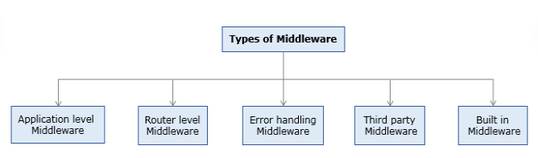
Types of Middlewares
The express framework provides the following five different types of middlewares.

Slide 77
Application Level Middleware
Application-level middlewares are functions that are associated with the application object. These middleware function will get executed each time an application receives a request.
The middleware that we have discussed earlier was also an application-level middleware.
app.use("/", route);

Slide 78
Application Level Middleware- Demo
Highlights:
Usage of middleware
Application-level middleware
Demo steps:
1. Modify the app.js file in the application by adding middleware to it.
const express = require('express');
const router = require('./Routes/routing');
const app = express();
// Customer logger middleware
const mylogger = function (req, res, next) {
console.log(`Req method is ${req.method}`);
console.log(`Req url is ${req.url}`);
next();
};

Slide 79
// using app object make use of logger middleware function
app.use(mylogger);
app.use('/', router);
app.listen(3000);
console.log('Server listening in port 3000');
2. The routing.js file content.
const express = require('express');
const router = express.Router();
const myController = require('../Controller/myController');
router.get('/', myController.myMethod);
router.get('/about', myController.aboutMethod);
module.exports = router;

Slide 80
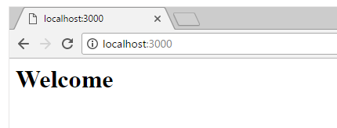
3. In Controller, add the below-mentioned code.
exports.myMethod = async (req, res, next) => { res.send('<h1>Welcome</h1>');
};
exports.aboutMethod = async (req, res, next) => {
res.send('<h1>About Us Page</h1>');};
4. Run the application using 'node app' and observe the output.

Slide 81
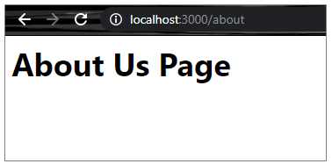
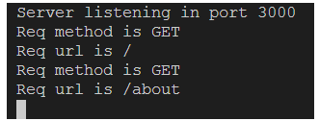
On changing the URL to 'http://localhost:3000/about', we get the below message:
The middleware output can also be seen in the console as shown below:

Slide 82
Router Level Middleware
Router-level middlewares are functions that are associated with a route. These functions are linked to express.Router() class instance.
Let us see how to use the router-level middleware in our application.
Highlights:
Usage of middleware
Router level middleware

Slide 83
Demo steps
1. Modify routing.js file by adding a middleware in it.
const express = require('express');
const router = express.Router();
const myController = require('../Controller/myController');
router.use((req, res, next) => { console.log(`Req method is ${req.method}`); console.log(`Req url is ${req.url}`); next();
});
router.get('/', myController.myMethod)
router.get('/about', myController.myaboutMethod)
module.exports = router;

Slide 84
2. Add the below code to the Controller:
exports.myMethod = async (req, res) => { res.send('Welcome');
};
exports.myaboutMethod = async (req, res) => {
res.send('About us');
};
3. The app.js file in TestApp.
const express = require('express');
const router = require('./Routes/routing');
const app = express();
app.use('/', router);
app.listen(3000);
console.log('Server listening in port 3000');

Slide 85
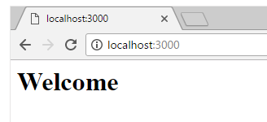
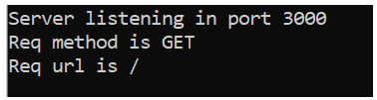
4. Open a command prompt and start the server. Observe the output

Slide 86
Demo 2: Router Level Middleware
If we want to use middleware for only a specific route, we can use the below code:
Highlights:
Usage of middleware for specific routes
Router level middleware
1. Modify routing.js file by adding a middleware in it.
const express = require('express');
const router = express.Router();
const myController = require('../Controller/myController');

Slide 87
Demo steps:
router.use('/about', (req, res, next) => { console.log(`Req method is ${req.method}`); console.log(req.originalUrl); next();
});
router.get('/', myController.myMethod)
router.get('/about', myController.myaboutMethod);
module.exports = router;

Slide 88
2. In app.js add the below-mentioned code:
const express = require('express');
const router = require('./Routes/routing');
const app = express();
app.use('/', router);
app.listen(3000);
console.log('Server listening in port 3000');

Slide 89
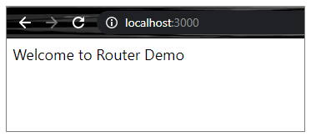
3. In Controller, we have the below code.
exports.myMethod = async (req, res) => { res.send('Welcome to Router Demo');
};
exports.myaboutMethod = async (req, res) => {
res.send('About us');
};
4. Run the application and observe the below output.

Slide 90

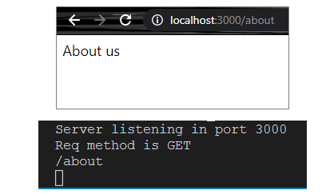
In the console we can observe the middleware is not logged:
On changing the URL to http://localhost:3000/about:

Slide 91
Error Handling Middleware
It provides the error-handling capability in an Express application. Whenever any run-time error occurs in the application, Express will call the error-handling middleware. The middleware can handle any type of run-time error and also format the error into a user-friendly error message.
The best way to handle the errors is by creating an error object with the error status code and error message and by throwing the error object. This can be passed to the errorlogger[custom method] which can handle it appropriately.

Slide 92
app.js
const express = require('express');
const errorLogger = require('./errorlogger')
const app = express();
app.all('*', (req, res, next) => {
let err = new Error();
err.message = 'Invalid Route';
err.status = 404;
next(err);
});
app.use(errorLogger)
app.listen(3000);
console.log('Server listening in port 3000');
module.exports =app;

Slide 93
errorlogger.js
This code will log the details to the ErrorLogger.txt and will send the response to the client.
const fs = require('fs');
let errorLogger = (err, req, res, next) => {
if (err) {
fs.appendFile('ErrorLogger.txt', `${new Date().toDateString()} - ${err.message}\n` , (error) => {
if (error) {
console.log("logging failed");
}
});
if(err.status){
res.status(err.status);
}
else{
res.status(500)
}
res.json({
status: 'error',
message: err.message
})
}}
module.exports = errorLogger;

Slide 94
Demo-Error Handling Middleware
Highlights:
Handling error in Express application
Usage of error handling middleware
1. Modify the file app.js as shown below.
const express = require('express');
const errorLogger = require('./errorlogger')
const app = express();

Slide 95
Demo steps
app.all('*', (req, res, next) => {
let err = new Error();
err.message = 'Invalid Route';
err.status = 404;
next(err); });
app.use(errorLogger)
app.listen(3000);
console.log('Server listening in port 3000');
module.exports =app;

Slide 96
3. In the errorLogger, add the below code
const fs = require('fs');
let errorLogger = (err, req, res, next) => {
if (err) {
fs.appendFile('ErrorLogger.txt', `${new Date().toDateString()} - ${err.message}\n` , (error) => {
if (error) { console.log("logging failed"); }
});
if(err.status){ res.status(err.status); }
else{ res.status(500) }
res.json({
status: 'error', message: err.message })
}}
module.exports = errorLogger;

Slide 97
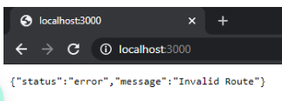
4. Save and run the app. Observe the JSON data as output:
Having an error bring down your entire app in production is never a great experience. Good exception management is important for any app, and the best way to deal with errors is to use the async structures.

Slide 98
Third Party Middleware
Third-party middleware provides the capability of adding more functions to an Express application using a third party module.
For using any third-party middleware in the Express application, the corresponding module for that particular functionality is to be installed, and then it is to be loaded at the application level or router level based on the requirement.
Some of the commonly used middlewares are:
body-parser
cookie-parser
helmet
session

Slide 99
Body Parser
The users are always prompted to enter data in a form, which is a powerful tool in any web application. On submitting the forms using the POST method, the data is sent as part of the request's body.
The form data is hence not exposed in the URL. POST submission handling is therefore different from GET submissions and it needs more processing.
The Express framework provides a middleware 'body-parser' for extracting the data coming as part of the request body, whenever the client sends any request.
To access the POST parameters, it provides a body property for the request object.

Slide 100
This middleware can be installed using the below command, for use in an Express application:
npm install body-parser
Consider the code snippet to use this middleware in the application.
const bodyParser = require('body-parser');
app.use(bodyParser.json());
The body-parser middleware is imported into the application and then associated with the application object using app.use() method.
The above code snippet uses bodyParser.json() method to parse the content.

Slide 101
Build-In Middleware
Built-in middleware is a set of functions that are built-in with Express.
Express has the following built-in middleware functions:
express.static serves static assets such as HTML files, images, and so on.
express.json parses incoming requests with JSON payloads.
express.urlencoded parses incoming requests with URL-encoded payloads.
Payload data in NodeJs is just packets or chunks of data sent to the server and that cannot be accessed ordinarily.

Slide 102
Connecting to MongoDB with Mongoose:
Organizations use various databases to store data and to perform various operations on the data based on the requirements.
Some of the most popular databases are:
Cassandra
MySQL
MongoDB
Oracle
Redis
SQL Server
A user can interact with a database in the following ways.
Using query language of the respective databases' - eg: SQL
Using an ODM(Object Data Model) or ORM(Object-Relational Model)

Slide 103
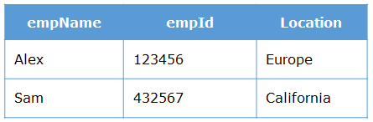
Need for ODM
Let us assume, we wish to maintain the details of the employees in the below format in the MongoDB database.
If we try to insert the below employee record into the collection(DB table), it will be inserted.
{empName : "John", employeeId : 324123, Location : "France"}

Slide 104
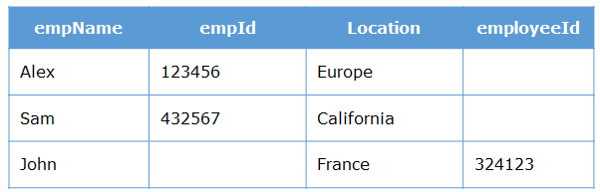
But if we carefully observe, the below record did not exactly match the format as we discussed. After inserting the above record, the collection will be looking as shown below:
MongoDB stores the data in the form of a document(row) in the collection. Since there is no predefined structure and constraints on values for fields, a document of any structure having any value for fields can be inserted into the collection.

Slide 105
It becomes the responsibility of developers to strictly maintain the structure of the document and apply constraints on the values for fields, which can be easily violated.
So, we need a library that can maintain or model the structure of documents and impose restrictions on the values for fields.
In order to ensure that the structure of the database is maintained, we need an Object Data Modeler, which ensures the maintenance of the collection.

Slide 106
ODM
An ODM is used to map the data as JavaScript objects to the underlying database format. They provide an option to perform validation and checking data to ensure data integrity.
There are many ODM based libraries available on NPM. One such library is Mongoose.

Slide 107
Mongoose
Mongoose is an Object Data Modeling (ODM) tool, which is created to work on an asynchronous MongoDB environment.
It imposes the structure and constraints by mapping JavaScript objects to documents in the database.
It also provides the functionality for validating field values and methods for selecting, adding, modifying, and deleting documents in the collection.

Slide 108
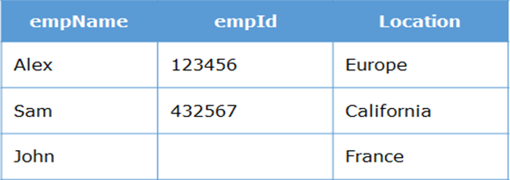
If we insert the same employee record with the help of Mongoose, then the collection will be looking as shown below:

Slide 109
Here, we can observe that the field which did not match the name in the collection will not be inserted. If we had set a required constraint for the empId field, then the document will not be inserted at all.
Let us now try to insert the below employee record into the collection. Notice here that the below record did not match the value as expected, for the field empId.
{ empName : "John", empId : "324123", location : "France"}

Slide 110
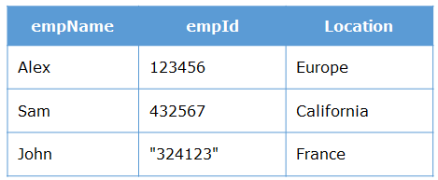
Without using Mongoose, if you try to insert the above record, the record will be inserted successfully and the collection will be looking as shown below:

Slide 111
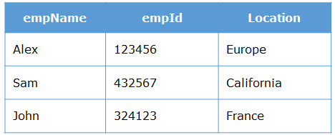
If we try to insert the above record with the help of Mongoose, then the collection will be looking as shown below:

Slide 112
We can observe that the value for the empId field got type-cast to Number type. This is because Mongoose did a type-cast.
If Mongoose is not able to convert the value to the specified type, then the document will not be inserted.

Slide 113
Schema and Models
Schema:
The structure of the document to be inserted in the database collection is defined through 'schema' in mongoose. Using schema, we can perform validations, provide default values to the properties, etc.
Example:
const empSchema = [ {
empId: Number,
empName: String,
address: { doorNo: String, lane: String, pincode: Number, },
},
];

Slide 114
Models:
We need to interact with the database collection to store or retrieve data. In order to perform database interaction, mongoose provides a 'Model' method that takes the predefined schema and creates an instance of a document that is like the records of the relational database. It provides an interface to the database for creating, querying, updating, deleting records, etc. A Mongoose model is a wrapper on the Mongoose schema.
Creating a Mongoose model comprises primarily of three parts:
Referencing Mongoose
Defining the Schema
Creating a Model

Slide 115
Referencing Mongoose
Installing Mongoose:
For installing the Mongoose library, issue the below command in the Node command prompt.
npm install --save mongoose
Executing the above command downloads the Mongoose library and add a dependency entry in your 'package.json' file.
Connecting to MongoDB using Mongoose:
To establish a connection to the MongoDB database, we need to create a connection object using Mongoose. This is done through the below code:
const mongoose = require('mongoose');
mongoose.connect( 'mongodb://localhost:27017/Database_Name');

Slide 116
In Line 1, we are importing the Mongoose library into our application.
In Line 2, the connect() method takes MongoDB protocol followed by the host and the database name as a parameter.
Let us now establish a connection to the MongoDB database IntellectNotes for storing details using the below code:
const mongoose = require('mongoose');
mongoose.connect('mongodb://localhost:27017/IntellectNotes', {
useNewUrlParser: true,
useCreateIndex: true,
useFindAndModify: false,
useUnifiedTopology: true,})

Slide 117
Line 2: Here we are specifying the URI where the data will be stored/retrieved. The second parameter
{useNewUrlParser:true, useCreateIndex:true, useFindAndModify: false,
useUnifiedTopology: true} is to suppress the below warnings thrown by MongoDB.
To create a collection using mongoose, we must start by creating a Mongoose schema.

Slide 118
Introduction to Mongoose Schema
A schema defines document properties through an object, where the key name corresponds to the property name in the collection. The schema allows you to define the fields stored in each document along with their validation requirements and default values.
To create a schema, we need to use the following lines of code:
const mongoose = require('mongoose');
const schema = new mongoose.Schema({ property_1: Number,
property_2: String
});

Slide 119
In a schema, we will define the data types of the properties in the document. The most commonly used types in the schema are:
String: To store string values. For e.g: employee name
Number: To store numerical values. For e.g: employee Id
Date: To store dates. The date will be stored in the ISO date format. For e.g: 2018-11-15T15:22:00.
Boolean: It will take the values true or false and is generally used for performing validations.
ObjectId: Usually, ObjectId is assigned by MongoDB itself. Every document inserted in MongoDB will have a unique id which is created automatically by MongoDB and this is of type ObjectId.
Array: To store an array of data, or even a sub-document array. For e.g: ["Cricket","Football"]

Slide 120
Creating Schema – Demo
myNotes wants to store notes id, name, and data for multiple users.
The code to create the required schema is given below:
const myNotesSchema = new mongoose.Schema( {
notesID: { type: Number, },
name: { type: String, },
data: { type: String, },
},
{ timestamps: { createdAt: true, updatedAt: true, },
});

Slide 121
Line 1: Using the Schema class provided by the Mongoose library, we can create the schema with all the necessary fields.
Note: It is a standard practice to have timestamps - (created at & updated at) field for each document inserted into the collection. This can be done by adding a timestamp option to the Schema.
To ensure data entered in the collection is as per the requirement, we can configure validations to the schema.

Slide 122
Validation types and Defaults
Validation through mongoose validator
Mongoose provides a way to validate data before you save that data to a database.
Data validation is important to make sure that "invalid" data does not get persisted in your application. This ensures data integrity. A benefit of using Mongoose, when inserting data into MongoDB is its built-in support for data types, and the automatic validation of data when it is persisted.
Mongoose’s validators are easy to configure. When defining the schema, specific validations need to be configured.

Slide 123
The following rules should be kept in mind while adding validation:
Validations are defined in the Schema
Validation occurs when a document attempts to be saved
Validation will not be applied for default values
Validators will not be triggered on undefined values. The only exception to this is the required validator
Customized validators can be configured
Mongoose has several built-in validators
The required validator can be added to all SchemaTypes
Number schema type has min and max validators
Strings have enum and match validators
Let us see how to add a validator to a Schema.

Slide 124
Validation types and default values
Required
If you want any field to be mandatory, use the required property.
const schema = mongoose.Schema({ name: { required: true, },
});

Slide 125
Types
You can declare a schema type using the type directly, or an object with a type property.
Example: To declare schema type using an object with a type property.
const schema = mongoose.Schema({ property_1: { type: String, },
property_2: { type: Number, },
});

Slide 126
Default
Your schema can define default values for certain properties. If you create a new document without that property set, the default value provided to that property will be assigned.
The below code snippet shows how to add a default to schema type:
const schema = mongoose.Schema({ property_1: { default: "Client" }, property_2: { default: 1 },
});

Slide 127
Custom validations
In Mongoose we can specify custom validators that are tailored specifically to fields if the built-in validators are not enough. They are provided as values of validate property.
The below code snippet shows how to add a custom validator to the schema type.
const schema = mongoose.Schema({ property_1: {
validate: (value) => {
/*Validation code*/
}
},
});

Slide 128
Demo: Adding Validation, types and default to myNotes Schema
const myNotesSchema = new mongoose.Schema( {
notesID: { type: Number,
unique: true,
required: [true, 'Required field'],
},
name: { type: String,
required: [true, 'Required field'],
},
data: { type: String, },
},
{ timestamps: { createdAt: true, updatedAt: true, },
});
Now that our myNotesSchema is ready, let us create a model for the schema.

Slide 129
Creating a model
The model provides an object which provides access to query documents in a named collection. Schemas are compiled into models using the model() method.
const Model = mongoose.model(name , schema)
The first argument is the singular name of the collection for which you are creating a Model.

Slide 130
The model() function makes a copy of the schema. Make sure that you have added everything you want to schema before calling the model().
Let us now create a model for our myNotes collection using the below code.
const NotesModel = mongoose.model( "mynotes", myNotesSchema);
Here NotesModel is a collection object that will be used to perform CRUD operations.
Now we have created the model for our database collection, let us insert some data into the collection.

Slide 131
Thank You

